Slide 1
WP2 Principal tensions and shortcomings of the European political systems, dimensions of empirical research
​
Lead SWPS
M2-6 (November 2022 – March 2023)

Slide 2
Two deliverables & one milestone
D2.1 Literature review: Illiberalism, Authoritarianism and Populism M5
D2.2 Guidelines for emprical data collection M6
Milestone – Guidelines for emprical data collection M6

Slide 3

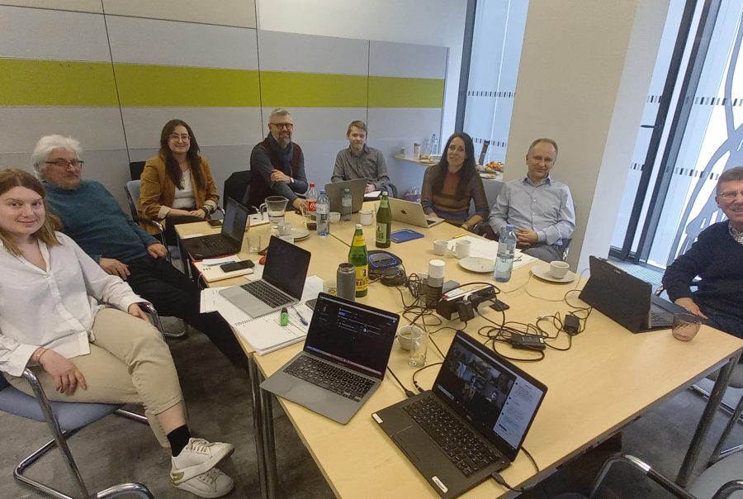
Key meetings
AUTHLIB consortium first virtual workshop on February 24, 2023
The workshop synthesized inputs from the consortium members before the finalization of the literature review, which laid the conceptual groundwork for the AUTHLIB project and paved the way for the operationalization of its key variables.
Hybrid internal workshop held on March 29, 2023 on-site at the University of Vienna and online
The workshop was relevant for advancing the discussion and laying out the general methodological approach of the project.

Slide 4
D2.1 Structure
What is illiberalism?
  Illiberalism as regime type: Illiberal democracies
  Illiberalism as ideology
  Bringing illiberal values and practices together
How is illiberalism different from authoritarianism and populism?
  Authoritarianism
  Populism
  Mapping illiberalism against authoritarianism and populism
  Sequencing illiberalism, authoritarianism and populism
Varieties of illiberalism
Postliberalism
Illiberal liberalism

Slide 5
WP2 = making sense of the rich literature and conceptual order
Populism, illiberalism, and authoritarianism (PIA) used interchangeably
All three challenge different aspects of liberal democracies (LDs), unveil specific traits and manifest idiosyncratic developments.
Divergent factors determine them and are facilitated by different socio-political contexts.
Conceptual order is needed.
PIA regimes competing with LDs placed within the grand frame of recent history, time sequence, and multiple contextual impacts.

Slide 6
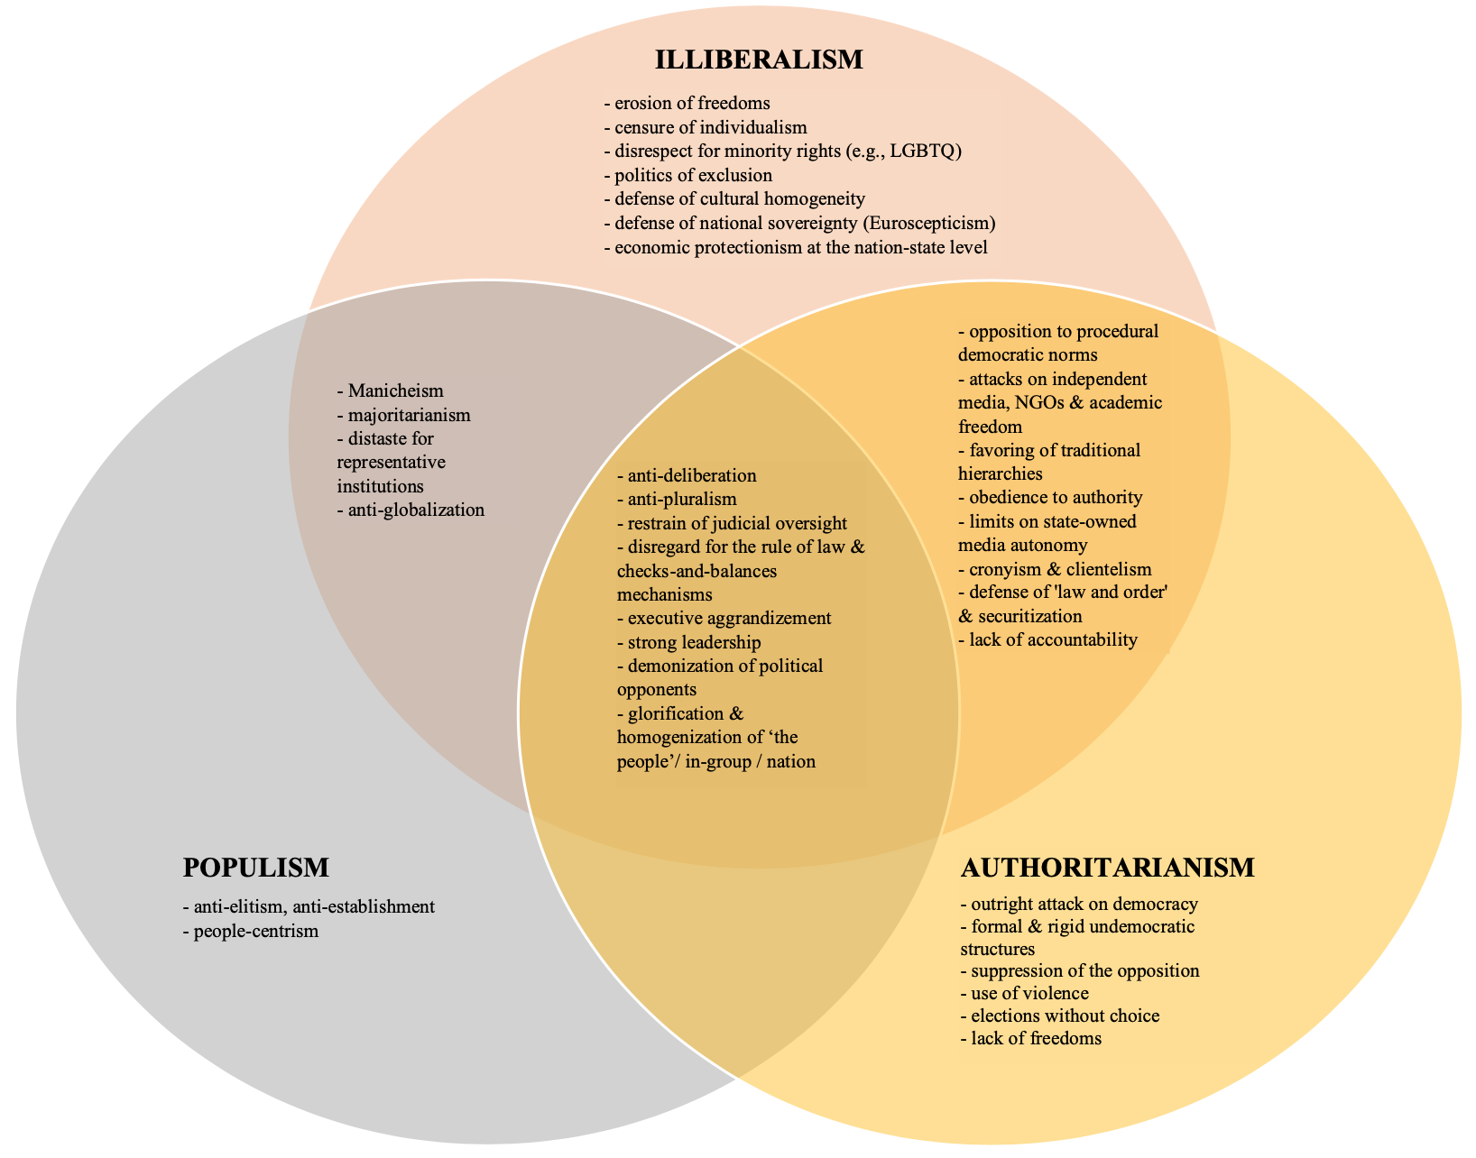
Populism – Illiberalism – Authoritarianism: overlaps & idiosyncrasies

Slide 7
Dynamics
PIA phenomena (as set of ideas, ideologies and regimes) ought to be analized dynamically → their sequence and gradualism
Typically: dismantling of LDs starts with Populism as it is relatively ”easy & low cost” & seems democratically legitimate.
Next: Illiberalism
Next: Authoritarianism
The sequence is by no means deterministic, nor universal.
Reverse developments happen – and depend on the public reaction

Slide 8
Concluding final sentence of D2.1
“We need empirical data to see where exactly illiberalism is situated on the democracy-autocracy axis, to what extent it is driven by a coherent set of values, and whether it is a transient phenomenon or if it is here to stay, eventually consolidating into a distinct regime type.”

Slide 9
D2.2 Guidelines for Empirical Data Collection
Research questions were specified and – where possible – structured hypotheses were put forward.
The levels and units of analysis were identified.
Methods and existing data sources were outlined.
Central issues and dimensions were described.

Slide 10
Key research questions
What are the core constitutive elements of illiberalism today as a set of ideas, ideologies, attitudes and political regimes and what are the main theoretical varieties of illiberalism?
Which elements of liberal democracy do illiberal citizens/parties oppose and which ones do they endorse? What are the different ideological combinations of political preferences (based on salient issues) and how are they related to the support and opposition to liberal democracy? Can we empirically distinguish different ideological flavours across opponents to liberal democracies, and if yes, what are they?
Can one identify inter-/trans-national impact on illiberalism and its particular models? Which are the most effective roots of transnational diffusion: from general cultural spirit to direct inter-party formal links, e.g. in the EU parliament?
How can liberal democratic actors respond to illiberal challenges?

Slide 11
Levels of analysis
Ideas and ideology itself
The political operationalization of ideology
The social-political response to ideologies
The nature of party-voter linkages

Slide 12
Central issues
democratic procedures and liberal democratic values
ideological underpinnings of illiberalism
illiberal citizens' psychological traits and attitudes
illiberal practices and policies
international relations, geopolitics, and supra-national institutions
democratic resilience to autocratization / responses to illiberal challenges

Slide 13
WP4 Survey-based data-collection and experiments on public attitudes
​
Lead SWPS
M7-25 (April 2023 – October 2024)

Slide 14
Five deliverables & one milestone
D4.1 An analysis of the relationship between socio-demographic attributes and the propensity to support particular types of neo-authoritarianism M24
D4.2 A data set that integrates information on the social characteristics of neo - authoritarianism (based on previous surveys – ESS, ISSP, EES, EVS) with the ideological configurations that emerged from WP3 M24
D4.3 A paper including a typology on the distribution of the types of illiberal orientations across the EU Member States M25
D4.4 A data set on the reactions of citizens in experimental setting M25
D4.5 A paper on the survey experiments, focusing on factors shaping attitudes towards liberal democracy M25
Milestone – Finalisation of the survey-based data collection M25

Slide 15
WP4 Main activities in M7-15
Compilation of existing studies, measures, and indicators relevant to the AUTHLIB survey
Design of the survey questionnaire
Design of the survey-embedded conjoint experiment
Preparation of the administration of the tender process

Slide 16
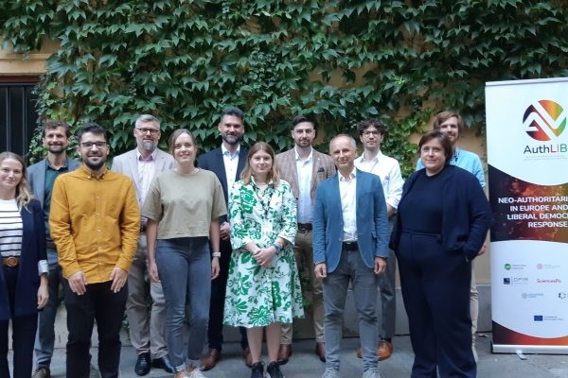
Key meetings
Hybrid internal workshop held on March 29, 2023 on-site at the University of Vienna and online
The initial collection of relevant items was showcased at the workshop. Consensus was reached on which elements from previous surveys should be included to ensure comparability and which new items should be developed.
Meeting at the ECPR General Conference (September 4-8, 2023)
Preliminary draft of the questionnaire and options for polling companies to administer the survey were discussed

Slide 17
Compilation of existing studies, measures, and indicators
Relevant measures and indicators from the European Social Survey (ESS), World Values Survey (WVS) and European Values Survey (EVS), International Social Survey Programme (ISSP), Comparative Study of Electoral Systems (CSES), Americas Barometer, and other sources were selected after assessing their suitability for AUTHLIB Survey goals and utilization in the extant literature.
Several batteries and indicators from the ESS, WVS and EVS were analysed using statistical methods such as Principal Factor Analysis and pairwise correlations to assess their consistency and relevance for the project.

Slide 18
Design of the survey questionnaire
Several iterations of the questionnaire were prepared, consulted with Consortium partners and amended according to the received comments. The main task was to choose from existing measures the most suitable ones and come up with new ones if there was a lack of reliable measures.
Due to the time constraints in administering the online survey (max. 25 minutes, including the experimental module), Consortium partners negotiated which items are to be included in the final version. Examples of past use, the reliability of indicators, the criticality of their inclusion and direct relationship to illiberalism were some of the most important criteria for decision-making.
The questionnaire is expected to be finalised by the end of March 2024. It consists of 41 questions (some of them with several items in batteries) ranging from such political attitudinal and behavioural aspects as normative evaluations of democracy, ideological underpinnings of illiberalism, authoritarian and populist attitudes, vote choice to socio-demographic items.

Slide 19
Design of the survey-embedded conjoint experiment
Discussions have covered aspects like statistical power, the optimal number of iterations per participant, and the number and levels of attributes.
The concept of varying levels of populism, illiberalism, and authoritarianism in a party’s policy implementation has been selected as the key attribute, together with its positions on cultural and economic dimensions of political competition
A decision to include three iterations of three separate forced choice selections was made to cover the following three dimensions of populist, illiberal and authoritarian challenges to liberal democracy separately: democratic principle of rule of law, free and fair elections, and civil liberties.
We are finalising the design by refining the specific wording and testing for plausibility of all hypothetical party profiles.
The total number of conjoint forced choices is nine and the estimated time 7 minutes

Slide 20
Preparation of the administration of the tender process
Announced xx-xx-xxxx with 21 days of period for submitting bids
Channels:
  public information bulletin
  emails sent directly to research agencies
Subject of contract:
  Survey study with choice based conjoint experiment in seven countries: Poland, Czech Republic, Hungary, Italy, Austria, France, and the United Kingdom; conductes in June 2024 on on a representative sample of the eligible population of each country (16 and over for Austria and 18 and over for the rest of the countries, with no upper age limit).
  Aim of the survey: to provide data on illiberal, authoritarian and populist orientations which enable to identify the mechanisms behind the acceptance and rejection of particular illiberal/authoritarian/populist frames.

Slide 21
Conditions for participation in the procedure
Knowledge and experience necessary to execute the order, including technical ability to conduct the study and prior experience in conducting multicountry studies;
Human and technical resources necessary to execute the order:
  experienced person who will personally participate in the execution of the order;
  has access to panels in excess of ≥ 10,000 individuals in each of the countries of study;
  access to survey networks in Poland, Czech Republic and Hungary
Tenderers who have capital or personal connections with the Ordering Party are excluded from the procedure.

Slide 22
Evaluation criteria
Criteria | Weigth
CRITERION I: order price | 50%
CRITERION II: experience of individuals designated to carry out the order | 20%
CRITERION III: access to panels in excess of ≥ 10,000 individuals in each of the countries of study. | 21%
CRITERION IV: access to survey networks in Poland, Czech Republic and Hungary | 9%
TOTAL | 100 points

Slide 23
WP4: STEPS AHEAD
Finalising the design of the AUTHLIB Survey Questionnaire (March 2024)
Finalising the design of the AUTHLIB Survey Conjoint Experiment Module (April 2024)
Translating AUTHLIB Survey into local languages (April-May 2024)
Finalising the tender process: selection of the subcontractor (April-May 2024)
Collaboration in survey programming and pre-testing (May-June 2024)
Quality assurance in sampling, fieldwork and data (June 2024)
Finalisation of the dataset and handing-in of the deliverables of WP4 (June-October 2024)

Slide 24
Conjoint Experiment Module
Following several meetings of the AUTHLIB survey questionnaire team between September 2023 and February 2024, and meetings during the same time frame of a smaller group with experience of fielding conjoint experiments, the key structure and logic of the conjoint experiment was agreed upon.
Extensive discussion was necessary in order to identify the correct balance between the research needs of the project, budgetary limitations, and statistical power required for meaningful results.
Drawing on prior experience of fielding similar experiments, the conjoint experiment module will last an estimated 7 minutes.

Slide 25
Conjoint Experiment Module
The essential logic of the conjoint experiment is as follows.
Respondents will be asked to choose between two parties making campaign promises, both of whom are presented as credible potential parties of government.
Each of the parties will be associated with a left-wing, centrist or right-wing economic policy promise, a left-wing, centrist or right-wing cultural policy promise, and a position on the delivery of promises that corresponds to one of the three key concepts of populism, authoritarianism and illiberalism, with liberal approaches to policy delivery as an additional control.

Slide 26
Conjoint Experiment Module
Economic policy | Left wing | Centrist | Right wing
Cultural policy | Left wing | Centrist | Right wing
PIA means | Populist | Illiberal | Authoritarian | Liberal (as control)

Slide 27
Conjoint Experiment Module
Three questions will be asked for each of the 9 iterations of the conjoint:
  1) Which party do you prefer (A or B)?
  2) On a scale from 0-10, how much do you support party A (0= not at all, 10=very highly)
  3) On a scale from 0-10, how much do you support party B (0= not at all, 10=very highly)

Slide 28
Conjoint Experiment Module
The wording of the questions is currently undergoing development. The team working on the conjoint experiment module has agreed on the fundamental nature of the conjoint policy choices and the populist / illiberal / authoritarian framings.
However, given the need to be careful about issues of translation, project members with native knowledge of the languages of our survey are currently drafting questions independently, in advance of a question reconciliation session scheduled for the third week of March.
Following this meeting, a finalized wording for the conjoint module will be forwarded to the wider survey team for approval.

